Slide 1
Operating System Structures
Muhammad Amin

Slide 2
Contents
System Components
Operating System Services
System Calls
System Programs
System Structure
Virtual Machines
Jan 30, 2024
Operating Systems - Muhammad Amin

Slide 3
Common System Components
Process Management
Main Memory Management
File Management
I/O System Management
Secondary Management
Networking
Protection System
Command-Interpreter System
Jan 30, 2024
Operating Systems - Muhammad Amin

Slide 4
Protection System
Protection refers to a mechanism for controlling access by programs, processes, or users to both system and user resources
The protection mechanism must:
  distinguish between authorized and unauthorized usage
  specify the controls to be imposed
  provide a means of enforcement
Jan 30, 2024
Operating Systems - Muhammad Amin

Slide 5
Command-Interpreter System
Many commands are given to the operating system by control statements which deal with:
  Process creation and management
  I/O handling
  Secondary-storage management
  Main-memory management
  File-system access
  Protection
  Networking
Jan 30, 2024
Operating Systems - Muhammad Amin

Slide 6
Command-Interpreter System (Cont.)
The program that reads and interprets control statements is called variously:
  command-line interpreter
  shell (in UNIX)
Its function is to get and execute the next command statement
Jan 30, 2024
Operating Systems - Muhammad Amin

Slide 7
Process Management
Creation/deletion of a process
Create and make available, an execution environment
Suspension/resumption and CPU scheduling in a fair manner
Mechanisms for synchronization
Mechanisms for inter-process communication
Deadlock handling
Jan 30, 2024
Operating Systems - Muhammad Amin

Slide 8
Process
A Context for Computation
Defined by:
  Its CPU state:?
    (register values)
  Its address space:?
    (memory contents)
  Its environment:?
    (as reflected in operating system tables)
CPU registers contain the current state
  1. Processor Status Word (PSW): includes bits
    Privileged or normal
    Outcome of the last arithmetic operation (zero,-ve, +ve, overflow, carry)
    Which interrupts are allowed and which are not
Jan 30, 2024
Operating Systems - Muhammad Amin

Slide 9
CPU State
2. Instruction Register (IR):
  The current instruction being executed
3. Program Counter (PC):
  Address of the next instruction to be executed
4. Stack Pointer (SP):
  the address of the current stack frame, including function’s local variables and return information.
5. General purpose registers:
  used to store addresses and data values as directed by the compiler.
Jan 30, 2024
Operating Systems - Muhammad Amin

Slide 10
Memory Contents
Only a small part of an application’s data can be stored in registers. The rest is in memory.
Typically divided into a few segments:
  Text: the application's code
    Read-only: might be shared by a number of processes
  Data: the application's predefined data structures
  Heap: an area from which space can be allocated dynamically at runtime, using functions like new or malloc.
  Stack: where register values are saved
    local variables allocated
All the addressable memory together is called the process’s address space
Jan 30, 2024
Operating Systems - Muhammad Amin

Slide 11
Environment
Contains the relationships with other entities
A process does not exist in a vacuum
It typically has connections with other entities, such as
  A terminal where the user is sitting.
  Open files
  Communication channels to other processes, possibly on other machines.
These are listed in various operating system tables.
Jan 30, 2024
Operating Systems - Muhammad Amin

Slide 12
Operating System Services
Program execution – system capability to load a program into memory and to run it
I/O operations – since user programs cannot execute I/O operations directly, the operating system must provide some means to perform I/O
File-system manipulation – program capability to read, write, create, and delete files
Communications – exchange of information between processes executing either on the same computer or on different systems tied together by a network. Implemented via shared memory or message passing
Error detection – ensure correct computing by detecting errors in the CPU and memory hardware, in I/O devices, or in user programs
Jan 30, 2024
Operating Systems - Muhammad Amin

Slide 13
System Calls
System calls provide the interface between a running program and the operating system
  Generally available as assembly-language instructions
  Languages defined to replace assembly language for systems programming allow system calls to be made directly (e.g., C, C++)
Three general methods are used to pass parameters between a running program and the operating system
  Pass parameters in registers
  Store the parameters in a table in memory, and the table address is passed as a parameter in a register
  Push (store) the parameters onto the stack by the program, and pop off the stack by operating system
Jan 30, 2024
Operating Systems - Muhammad Amin

Slide 14
Virtual Machines
A virtual machine takes the layered approach to its logical conclusion. It treats hardware and the operating system kernel as though they were all hardware
A virtual machine provides an interface identical to the underlying bare hardware
The operating system creates the illusion of multiple processes, each executing on its own processor with its own (virtual) memory
Jan 30, 2024
Operating Systems - Muhammad Amin

Slide 15
Virtual Machines (Cont.)
The resources of the physical computer are shared to create the virtual machines
  CPU scheduling can create the appearance that users have their own processor
  Spooling and a file system can provide virtual card readers and virtual line printers
  A normal user time-sharing terminal serves as the virtual machine operator’s console
Jan 30, 2024
Operating Systems - Muhammad Amin

Slide 16

System Models
Non-virtual Machine
Virtual Machine
Jan 30, 2024
Operating Systems - Muhammad Amin

Slide 17
Advantages/Disadvantages of Virtual Machines
complete protection of system resources since each virtual machine is isolated from all other virtual machines. This isolation, however, permits no direct sharing of resources.
a perfect vehicle for operating-systems research and development. System development is done on the virtual machine, instead of on a physical machine and so does not disrupt normal system operation.
difficult to implement due to the effort required to provide an exact duplicate to the underlying machine
Jan 30, 2024
Operating Systems - Muhammad Amin
Notes:
The main advantages of system VMs are:
multiple OS environments can co-exist on the same computer, in strong isolation from each other
the virtual machine can provide an instruction set architecture (ISA) that is somewhat different from that of the real machine

Slide 18
Java Virtual Machine
Compiled Java programs are platform-neutral byte-codes executed by a Java Virtual Machine (JVM)
JVM consists of
  Class loader
  Class verifier
  Runtime interpreter
Just-In-Time (JIT) compilers increase performance
Jan 30, 2024
Operating Systems - Muhammad Amin

Slide 19
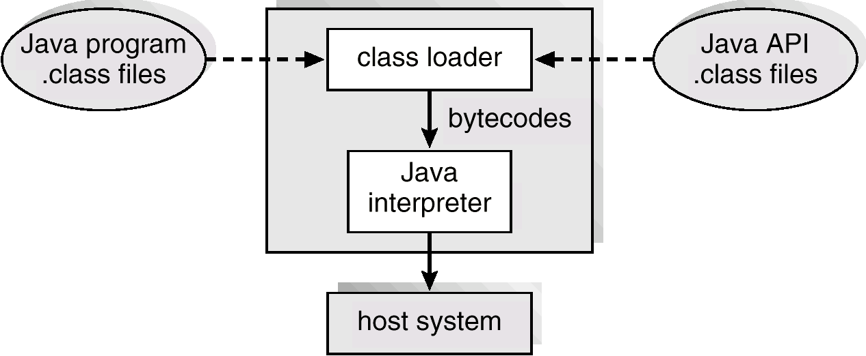
The Java Virtual Machine
Jan 30, 2024
Operating Systems - Muhammad Amin

Slide 20
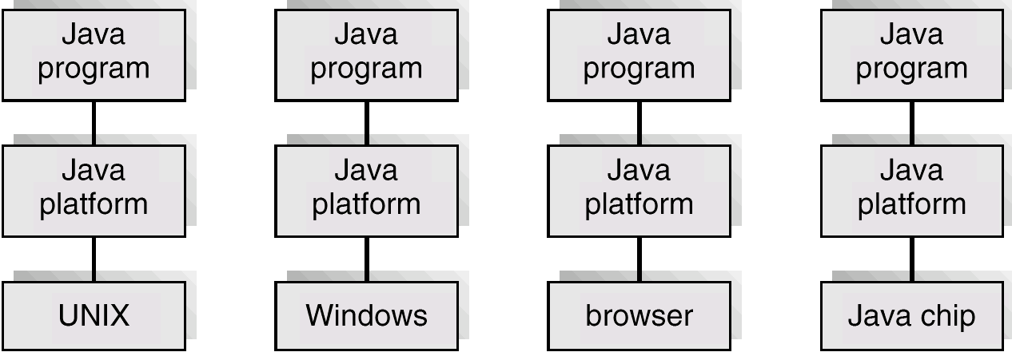
The Java Platform
Jan 30, 2024
Operating Systems - Muhammad Amin

Slide 21
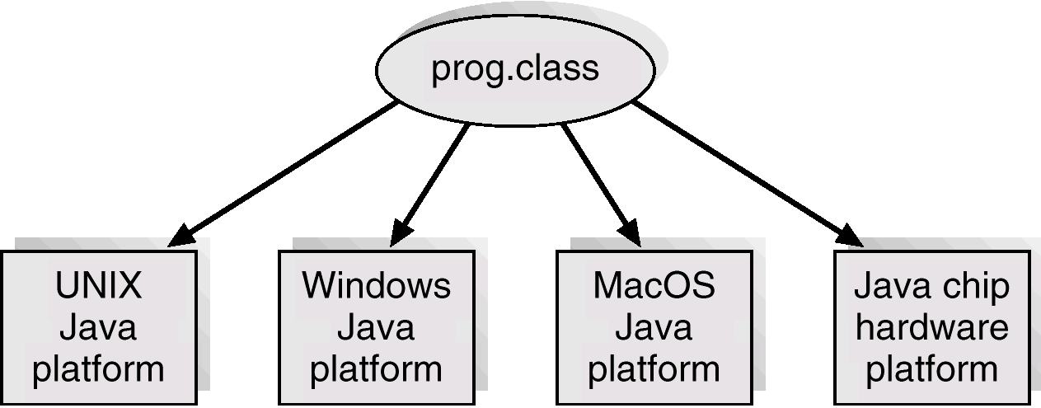
Java .class File on Cross Platforms
Jan 30, 2024
Operating Systems - Muhammad Amin

Slide 22
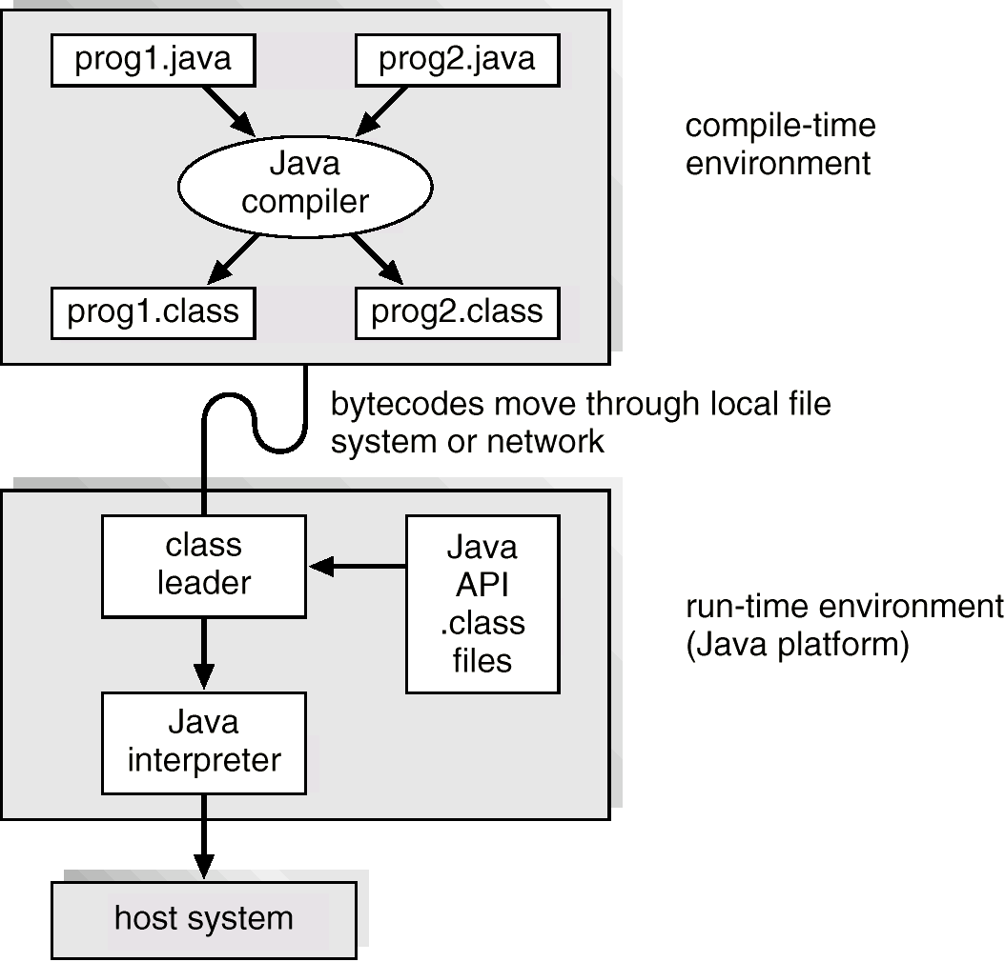
Java Development Environment
Jan 30, 2024
Operating Systems - Muhammad Amin

